Slide 1




VIRTUAL ASSISTANT
Team Details
Batch-D2
CHIRAG VERMA(16010221036)
2. ABHIRAJ KULKARNI(16010221031)

Slide 2
ACKNOWLEDGEMENT
We would like to express our special thanks of gratitude to our Python teacher Professor Rajashree Daryapurkar and Professor
Deepa Jain who gave us the golden opportunity to do this wonderful project on building a virtual assistant through Python.
It is our teacher’s guidance that helped us in understanding the intricacies of coding and the timely completion of this project.
We would also like to thank all the teaching and non-teaching staff of the Electronics department who helped us directly or indirectly in the completion of this project.
Finally, we would each like to express heartfelt thanks to our fellow teammate for their hard work and determination for the successful completion of this project.

Slide 3

INTRODUCTION
A virtual assistant is an application that understands voice commands and completes tasks for a user. Virtual assistants are available on most smartphones and tablets, traditional computers, and even standalone devices like the Amazon Echo and Google Home.
They combine specialized computer chips, microphones, and software that listen for specific spoken commands from you and can answer back in a voice that you select.

Slide 4
PROBLEM STATEMENT
In today’s technologically advanced world, almost every service has moved online. For e.g., Banking, Ticketing, etc.
This involves a wide range of tasks, but some of these can be minor but time-consuming. Rather than hiring a full-time employee, you can employ a virtual assistant to handle those tedious minor responsibilities .
A VA can help with tasks that are administrative or technical in nature.
Virtual assistants like these can do everything from answer questions, tell jokes, play music, and control items in your home such as lights, thermostats, door locks, and smart home devices.

Slide 5

SYSTEM ARCHITECTURE
It takes microphone input from the user and returns string output
The tasks it performs include:
It can send emails on your behalf.
It can play music for you.
It can do Wikipedia searches for you.
It is capable of opening websites like Google, Youtube, etc., in a web browser.
It is capable of opening your code editor or IDE with a single voice command.

Slide 6
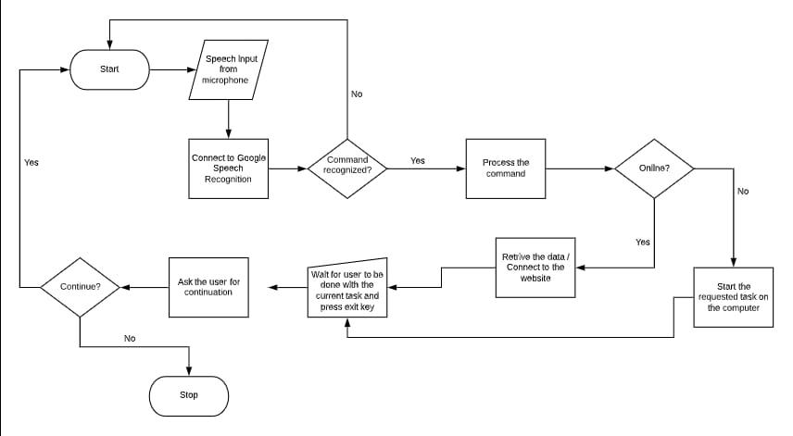
FLOWCHART

Slide 7

FEATURES OF DESIGNED SYSTEM
wishme() function will make our assistant wish or greet the user according to the time of computer or pc.
takeCommand() function will make our A.I. assistant return a string output by taking microphone input from the user.
sendEmail() function, which will help us send emails to one or more than one recipient.

Slide 8
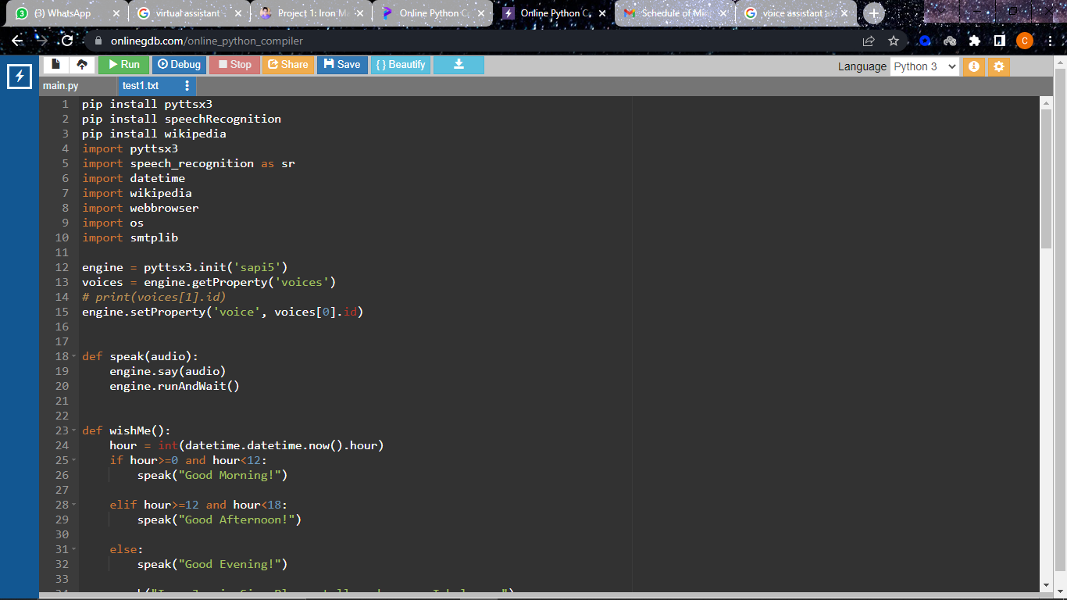
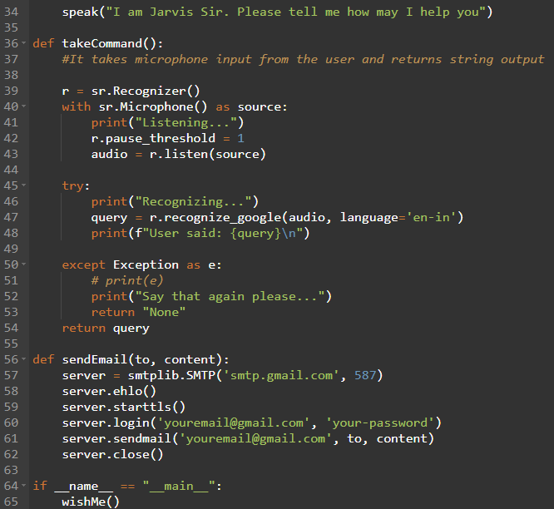
CODE

Slide 9
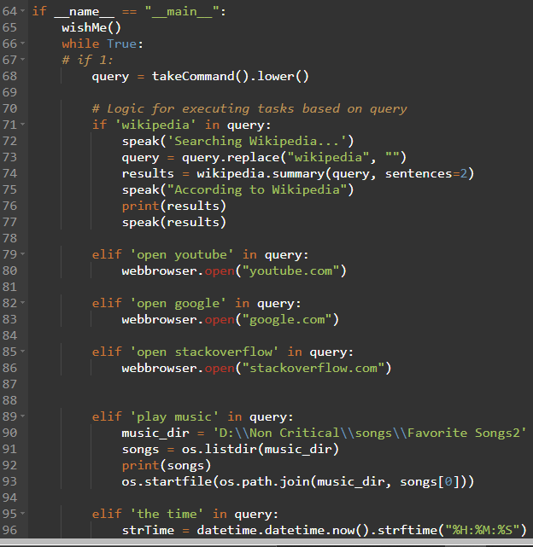
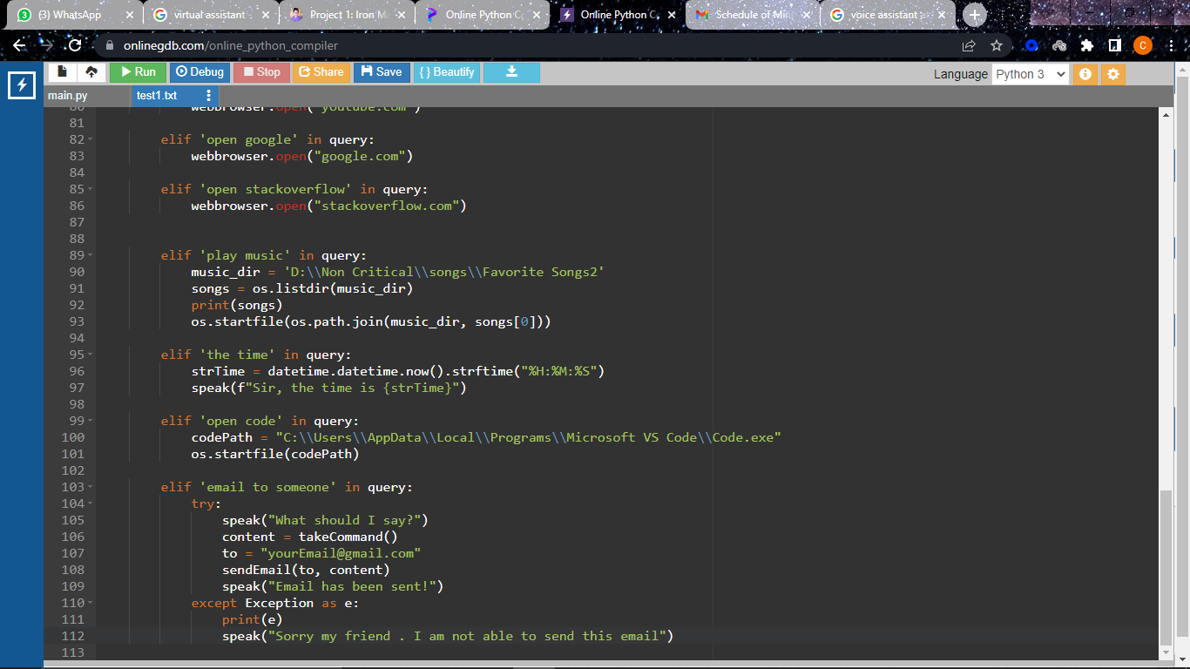
CODE

Slide 10
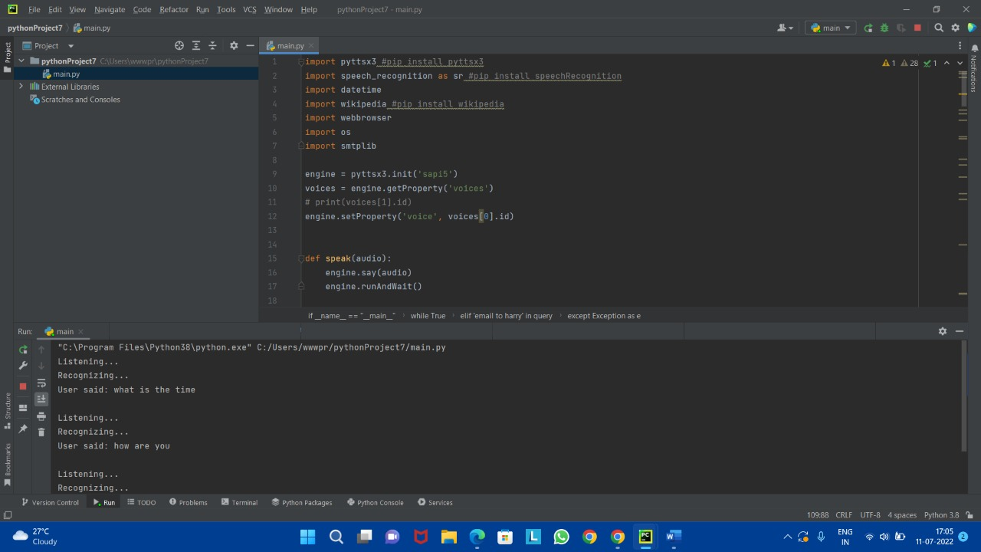
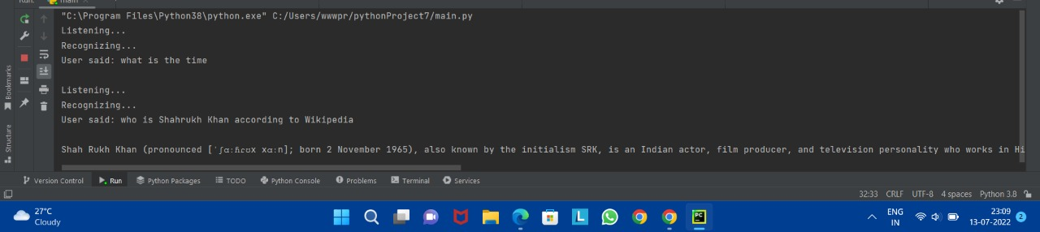
OUTPUT

Slide 11
CONCLUSION
With the help of this project, we are able to send emails without typing a single word, do Wikipedia searches without opening web browsers, and perform many other daily tasks like playing music with the help of a single voice command. In this mini project, we learnt how you can make your personal A.I. assistant using Python and importing pyttsx3 module.
We learned many different aspects of programming and we also learned about the pyttsx3 module which is used to convert text to speech.
This project has taught us team coordination, time management, and a lot of things.

Slide 12
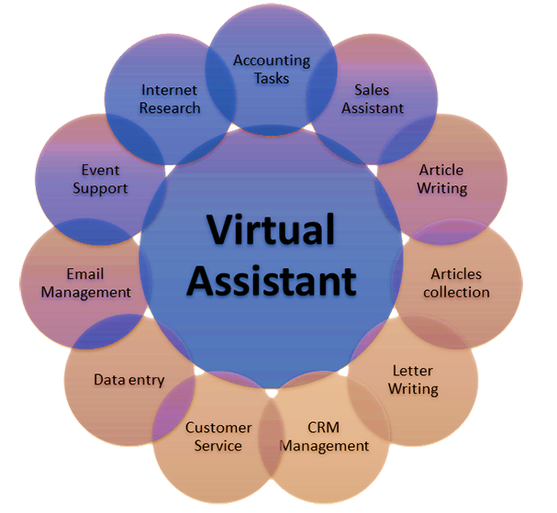

REFERENCES
1. https://www.codewithharry.com
2. https://geeksforgeeks.org

